Slide 1
Windvision
By Wacky Windmills

Slide 2

Recap of Windvision
We plan to utilize wind speed data from many locations to create a website with a user-friendly interface and easy for anyone to navigate, accessing data by searching or browsing.
NASA data processed and analyzed for accurate information, accessible by searching or browsing
The main goal is to present users with easy to read data in order to help them pick ideal locations for wind farms. However this data could be used for many applications

Slide 3
Timeline
January
February
March
April
Project Proposal
Finished Front-End
Work on Back-End
Finish Back-End + Presentation

Slide 4
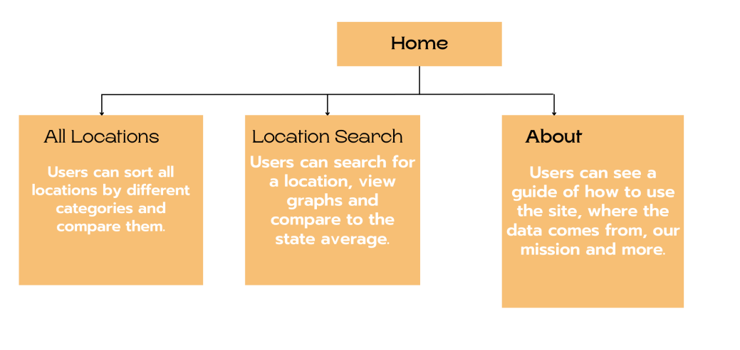
Sitemap

Slide 5
Data Problems
Original plan: Use wind speed, direction and temperature in Connecticut
Turns out there aren’t enough data points in CT to make it worth doing so now we’re doing the whole Northeast
Wind speed: Data is good and we were able to convert it into CSV
Wind direction: Can’t even find the data on NASA Giovanni
Air Temperature: Data points are so similar across most locations it’s not a useful metric
Where we’re at now: Using wind speed in Northeast and trying to figure out what the best other data points to use are

Slide 6
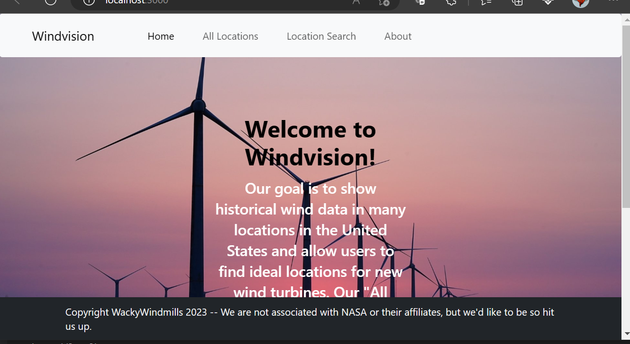
Demo

Slide 7
Thanks for Listening. Any Questions?

